Slide 1

Analyzing Performance: Apache Spark vs. Hadoop MapReduce
CS5229 - Big Data Analytics Technologies
248242V – H. M. Thinura L. Kumarasinghe
Notes:
"Hello, I'm Thinura Kumarasinghe, and today I'm pleased to present an analysis comparing the performance of two widely used frameworks for big data processing: Apache Spark and Hadoop MapReduce."

Slide 2

Hadoop MapReduce
MapReduce revolutionized big data processing, enabling handling of massive datasets.
Developed by Google in 2004, it's widely adopted across industries.
Operating via parallel processing, it efficiently divides and processes data for batch tasks.
Notes:
MapReduce revolutionized big data processing by enabling the handling of massive datasets previously impossible with traditional methods. Developed by Google in 2004, it's a programming model and framework designed for distributed processing. It partitions data into smaller chunks processed in parallel across cluster nodes. This process involves two main phases: mapping, where data is divided into key-value pairs and processed in parallel, and reducing, where intermediate results are combined to produce final outputs. MapReduce finds extensive use in batch processing tasks like data mining, log analysis, and web indexing.

Slide 3

Apache Spark
Apache Spark efficiently processes big data with unified support for batch, streaming, and machine-learning tasks.
It utilizes Resilient Distributed Datasets (RDDs) for scalable and fault-tolerant data processing.
Spark's built-in libraries for machine learning, graph processing, and stream processing make it widely adopted across industries.
Notes:
Apache Spark is a distributed computing system developed by the Apache Software Foundation for processing and analyzing big data. Released in 2012, it has gained widespread popularity due to its speed and versatility. Spark offers a unified engine for batch, streaming, and machine-learning tasks, built on top of the Hadoop Distributed File System (HDFS). It supports multiple programming languages like Java, Scala, and Python and utilizes Resilient Distributed Datasets (RDDs) to distribute data across cluster nodes efficiently. Spark includes libraries for machine learning, graph processing, and stream processing, making it ideal for industries such as finance, healthcare, e-commerce, and social media.

Slide 4
Demo
Notes:
Now I will show the demo.

Slide 5
Comparison
Feature | MapReduce | Apache Spark
Ease of Us | Requires writing complex and verbose code. | Offers higher-level APIs and intuitive syntax.
 | Higher development time and effort. | Reduces development complexity.
Processing Speed | Slower due to disk I/O overhead. | Faster processing enabled by in-memory computing.
 | Lack of in-memory processing. | Reduced execution times.

Slide 6
Ease of Use
MapReduce: Requires writing complex and verbose code, leading to higher development time and effort.
Apache Spark: Offers higher-level APIs and intuitive syntax, reducing development complexity and enabling faster prototyping.
Notes:
During the demonstration, we observed that MapReduce necessitates writing intricate and verbose code, often leading to increased development time and effort. Conversely, Apache Spark was showcased to offer higher-level APIs and a more intuitive syntax, thereby reducing the complexity of development tasks. Attendees could witness how Apache Spark's streamlined approach allows for faster prototyping and simplified implementation of data processing tasks, illustrating its superiority over MapReduce in terms of ease of use.

Slide 7
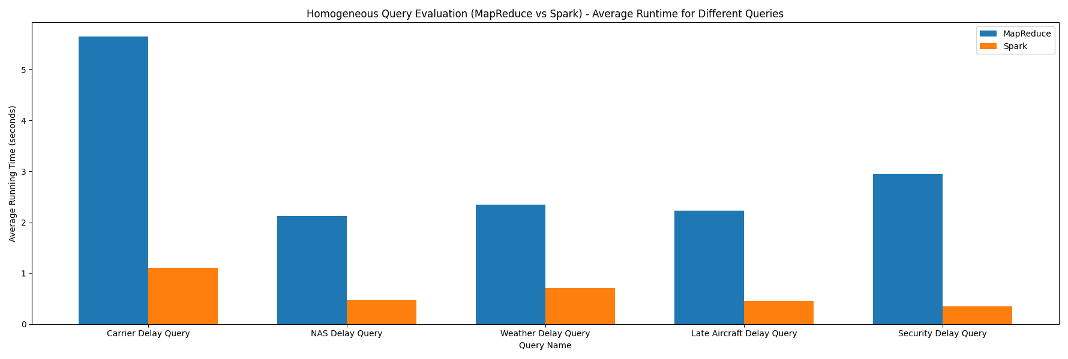
Fast Processing
MapReduce: Typically slower due to disk I/O overhead and lack of in-memory processing.
Apache Spark: Faster processing enabled by in-memory computing, leading to significantly reduced execution times.
Notes:
Based on the data presented in the chart, it's evident that Apache Spark demonstrates faster processing capabilities compared to MapReduce. Throughout the demonstration, attendees observed that Apache Spark's in-memory computing significantly reduces execution times, resulting in quicker data processing. On the other hand, MapReduce tends to be slower due to the overhead of disk I/O and its lack of in-memory processing. This analysis confirms Apache Spark's advantage over MapReduce in terms of processing speed, as shown in the chart.

Slide 8
Conclusion
Clear Advantage of Apache Spark.
Potential Impact on Decision-making.
Adoption of Apache Spark.
Continued Evolution.
Final Recommendation.
Notes:
In conclusion, the analysis presented unmistakably highlights Apache Spark's superiority over MapReduce in both ease of use and processing speed.
Apache Spark's higher-level APIs and in-memory computing capabilities streamline development efforts and significantly reduce processing times, as demonstrated in our comparison chart. This makes it a compelling choice for organizations seeking efficient and agile big data processing solutions.
Considering the clear advantages offered by Apache Spark, organizations are encouraged to consider adopting this framework for their data processing needs. Its potential to enhance productivity and accelerate data processing workflows can have a substantial impact on overall operational efficiency and decision-making processes.
As big data technologies continue to evolve, it's essential for organizations to remain proactive in exploring and leveraging advancements such as Apache Spark to stay competitive in today's data-driven landscape.
In conclusion, Apache Spark emerges as the preferred choice for organizations aiming to streamline their big data processing efforts, improve efficiency, and drive innovation in data analytics. Thank you for your attention, and we hope this analysis has provided valuable insights into the comparative strengths of MapReduce and Apache Spark.

Slide 9
Thank You !

